Slide 1

Your Personal
Healthcare Companion
Submitted By Gazi Tawsif Turabi 011201467 Mahady Hasan Sabbir 011201192 Md. Yousuf Talukdar 011193157

Slide 2
Contents
Introduction
Type 2 diabetes
Certain Cancers
Digestive Problems
Sleep apnea
Osteoarthritis
Eye Problems
Insomnia
ADHD Tests
Suicide Prevention Steps

Slide 3
About CARE ME
In this fast era, people have scarcity of time and system to take care of themselves. Our daily routine are not so healthy. This competitive and monotonous routine also affects our mental health. Also lack of healthy recreation like sports and gossiping makes us lean to unhealthy recreations to feel dopamine boost. That’s why we are planning to make an application which will help us to take care of our physical and mental health. It will tell us how much calorie we need, how much workout should we do, who to connect for consultancy for our better health.

Slide 4
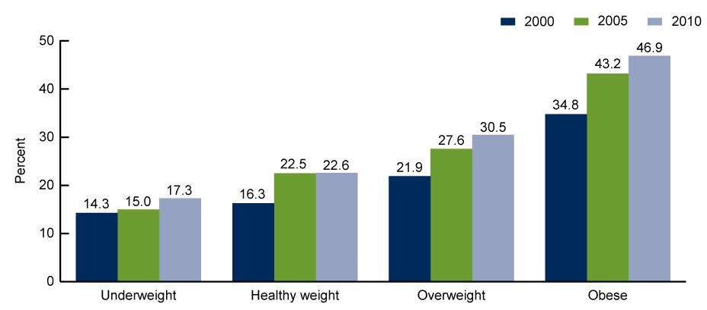
Physical Health
Our physical wellbeing helps us to struggle in hard time of life. So, we always have to be prepared and be fit. For being overweight we also face many kind of sickness which hinders our daily routine and important time. That’s why we need technology which will help us to do the best use of everything.

Slide 5

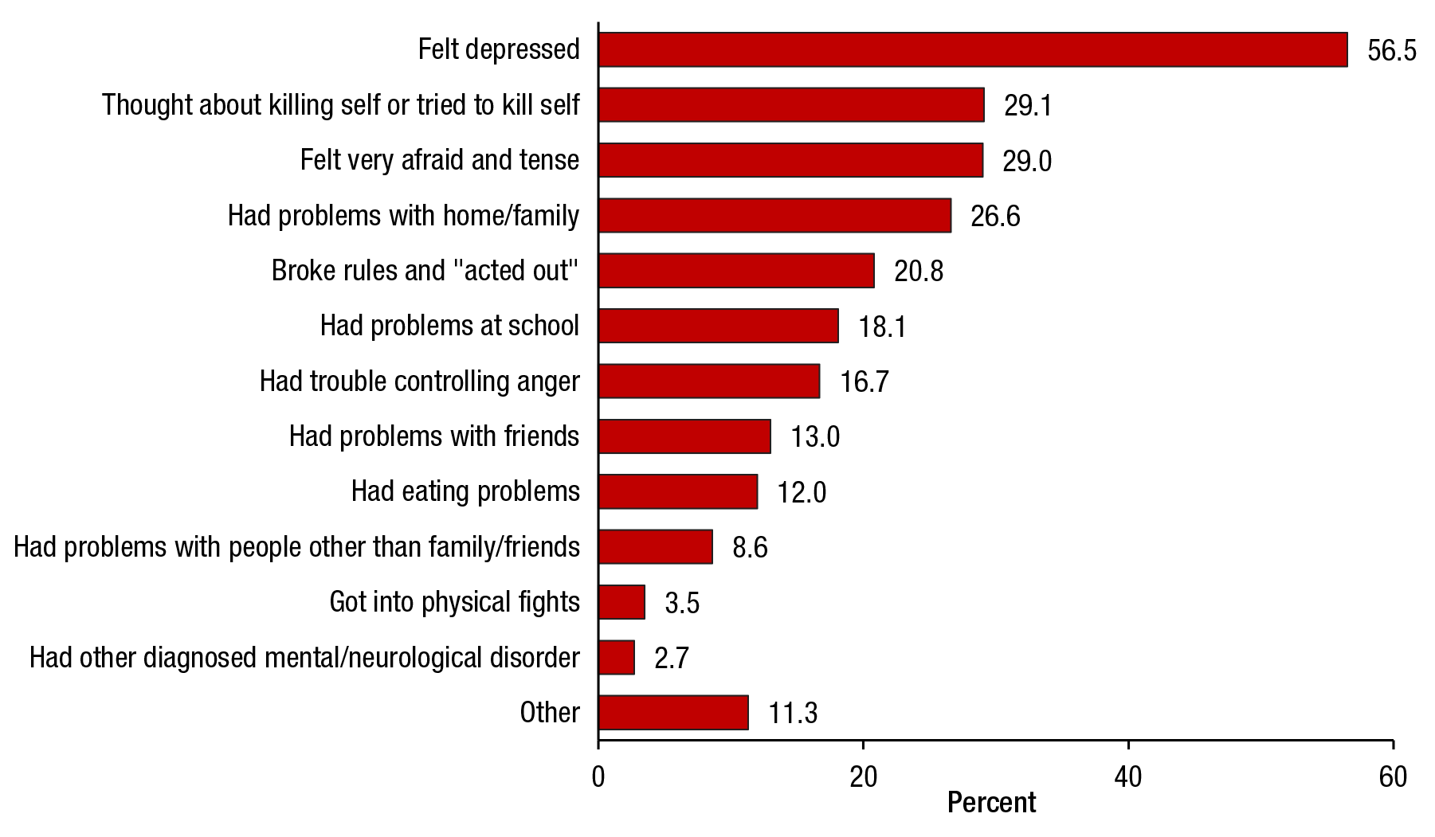
Mental Health
With new technology and modernization, new diseases are being discovered. So, we have to take steps to control our wrong uses of newer technologies. Day by day suicide rate is increasing. People are getting more depressed.

Slide 6
Diseases
Lots of common diseases comes from laziness, lack of sleep, sitting for too long, obesity, too much depending on electrical devices, being addicted to use these devices. Such diseases are-
Heart diseases and strokes
Type 2 diabetes
Certain Cancers
Digestive Problems
Sleep apnea
Osteoarthritis
Eye Problems
Depression
Anxiety Disorders
Insomnia etc.

Slide 7
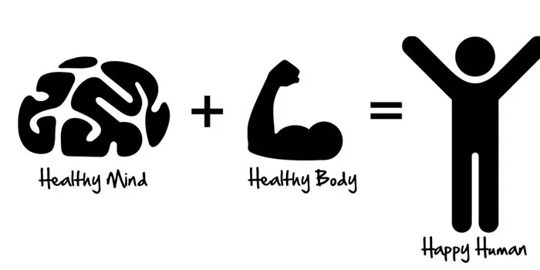
Benefits of Workout
Regular physical activity can improve your muscle strength and boost your endurance
Exercise delivers oxygen and nutrients to tissues and helps cardiovascular system work more efficiently which results more energy to tackle daily chores.
Study suggests exercise improves mental health by reducing anxiety, depression, and negative mood and by improving self-esteem and cognitive function.
It can also improve sleep, help mind recover.
Exercising regularly can reduce the symptoms of ADHD and improve concentration, motivation, memory, and mood.
Physical activity immediately boosts the brain's dopamine, and serotonin levels—all of which affect focus and attention.

Slide 8
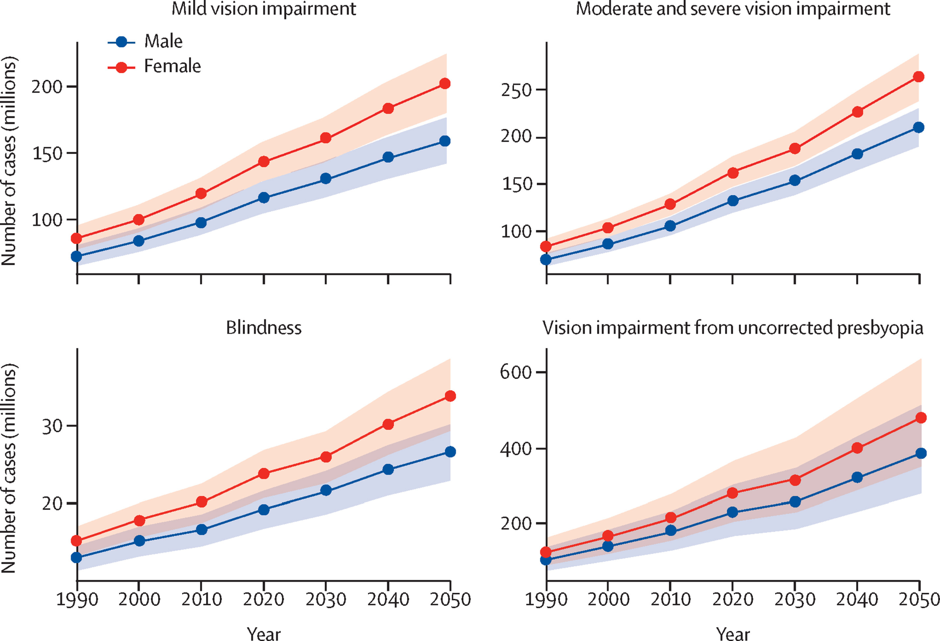
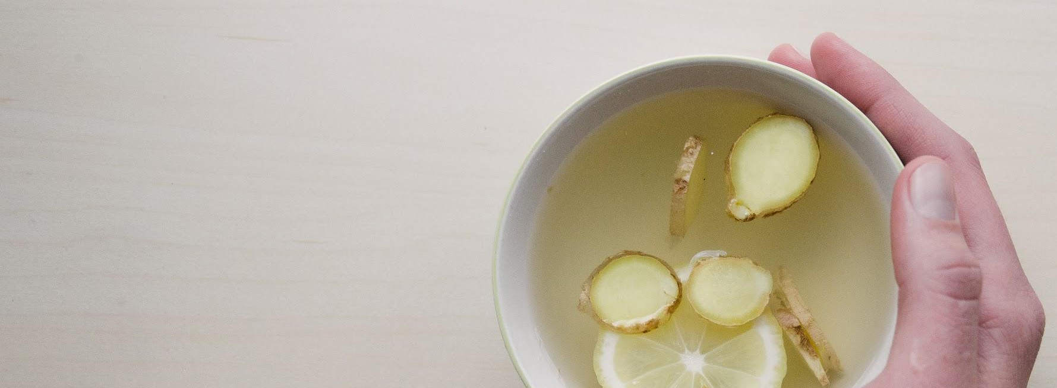




Slide 9
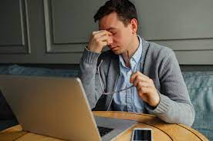
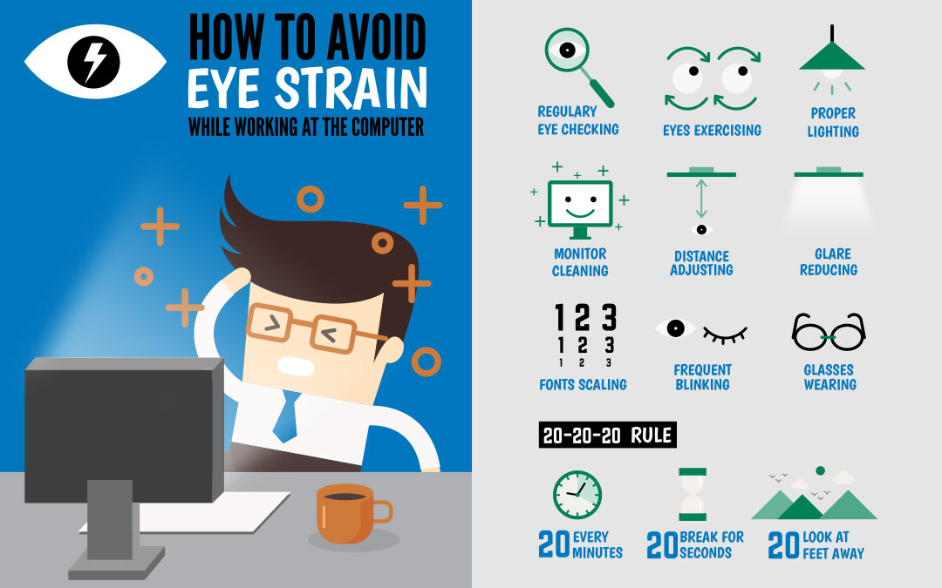
Eye Care
Overwatching electrical devices hampers our health by their Blue rays and radiation. Sometime people don’t watch it from recommended distance. Which causes shortness of eyesight. In this generation, many people can not walk without wearing glasses. Care Me helps it’s user by sending notifications that it is hazardous for that individual’s eye if that person further uses that electronic device. Lack of sleep and using these devices too much can hurt eyesight and brain nerve cells also. By following the tips that is application give we can use the best of our eyesight

Slide 10
Care Me
Features
In this application one can create his or her own account. CareMe requires informations like
Height
Weight
Waist Size
Workout History
Calorie Intake
Thus, the app can guess and give Diet Chart, Workout Routine, Sleep Timer, Longtime sitting Alert and help the individual.

Slide 11
Other Features
Care Me can also help an individual to maintain his or her mental health. Increased dopamine levels by watching video in internet lessens focus and concentration power for any time consuming study or work. Care Me can be customized to not to let the individual open or use certain app for significant amount of time.
It will also provide quizzes where someone can check their mental health. If their mental health become worse Care Me can make appointment with certified medical officers.
It will always give tips to become as healthy as possible. It can also prevent suicide attempts by connecting individual with certified rescuer.

Slide 12

User can also take help from our app to give up on any addiction like smoking, doing drugs. Our app will provide social group links where people always help each other by motivating and showing the bad results of addiction. User can track and write about their journey to give up addiction.

Slide 13
Programming and Technology
We will be using Java and JavaFX for Application programming.
To make the application accessible to multiple users,
we are going to use PHP and MySQL API to set and get data on the cloud.

Slide 14
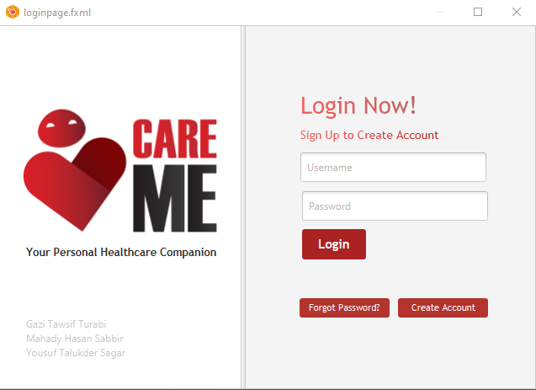
Some Preview
This is the login page. This will be the Same Login page for Users, Consultants and Doctors.

Slide 15
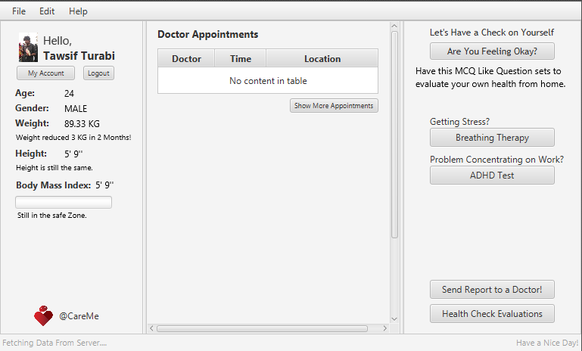
Some Preview
This is the home window showing all the statistics and Routines.
This is a Demonstration.
This might change.

Slide 16
Conclusion
We are working on our project with heart and soul. We want our application to be as much helpful as possible to all. We are trying to put all the features that can make a person’s daily routine healthy in on application. Our goal should become as better human as possible and contribute for our society. That’s our presentation.

Slide 17
Thank You

